Slide 1


Tri-Counties Regional Center (TCRC)
DS1891 Compliance Website
Information and Instructions
Biennial Requirement to Update Form DS1891 – Applicant/Vendor Disclosure Statement

Slide 2
DS1891 Update Process
Regulations dictate that Service Providers must update their DS1891 forms for all vendor numbers as a requirement for continued vendorization eligibility
Updates must be completed and submitted within 60 days of the notice from TCRC
TCRC will be using a web-based portal for Service Providers to update their DS1891 forms
TCRC will send an enrollment form to Service Providers asking for the name and email address of the person who will be the Portal Administrator

Slide 3
DS1891 Update Process
Once you return the enrollment form to TCRC, you will receive a username and password for login to the Portal, along with instructions
The URL for accessing the portal is www.sanctionscreeningnow.com
TCRC will be using a third party administrator, OIG Compliance NOW (OIG/CN), to conduct the Exclusion Checks
OIG/CN is a licensed investigative company based in upstate NY
The company specializes in sanction screening to identify “excluded” companies and individuals

Slide 4
OIG Compliance NOW (OIG/CN)
All names listed on the DS1891 forms (both individuals and businesses) will be checked by OIG/CN
OIG/CN will check both the Office of the Inspector General (OIG LEIE) and California Medi-Cal exclusion lists
Sanction screening checks business names, or first and last names of individuals
They will then investigate any name matches or “hits” that are discovered
Common names will “hit”, such as Maria Rodriguez, John Smith, and Pamela Anderson
An “excluded” party cannot receive Federal/State medical assistance money

Slide 5
OIG/CN Sanction Screening
OIG/CN Investigators will work to clear false name hits
If required, OIG/CN will call the Portal Administrator to obtain information needed to clear the name hits
Please complete as many fields on the DS1891 form as possible, so that OIG/CN can use that information to conduct their investigations

Slide 6
Portal Screen Shots & Instructions

Slide 7
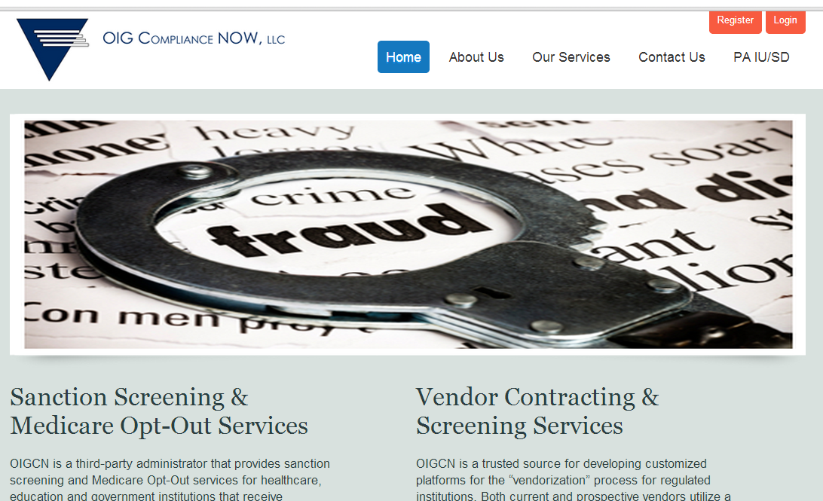
Registration
Go to www.sanctionscreeningnow.com
Click on the orange Register button on the home page

Slide 8
Registration
For Type of Business, select CA Regional Center Vendor
Then enter the vendor # that was provided to you by TCRC for registration purposes

Slide 9
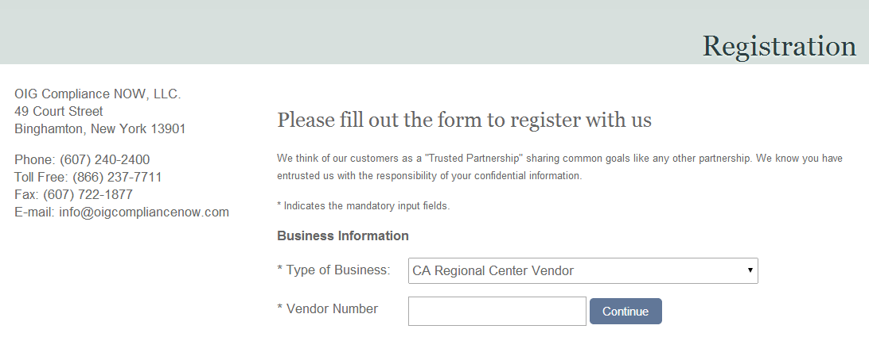
https://www.sanctionscreeningnow.com/OIGComplianceVendor/Registration.aspx/Form

Slide 10
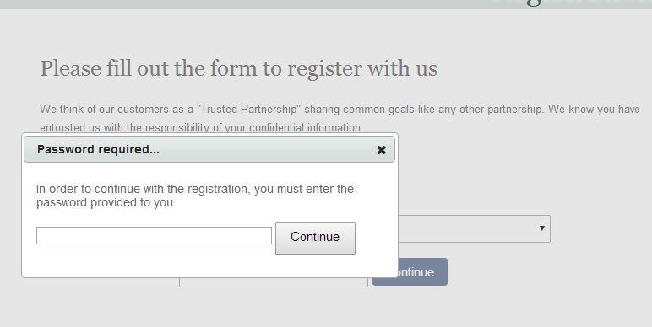
Registration
Then enter the password that was provided to you for registration

Slide 11
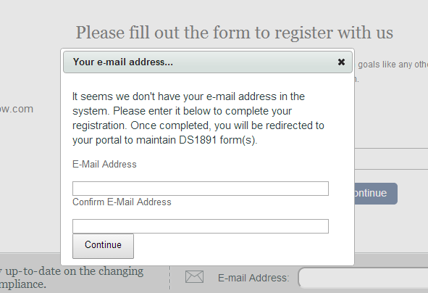
Registration
If the system does not have your email address on file, it will ask you to enter your email address and to confirm the address

Slide 12
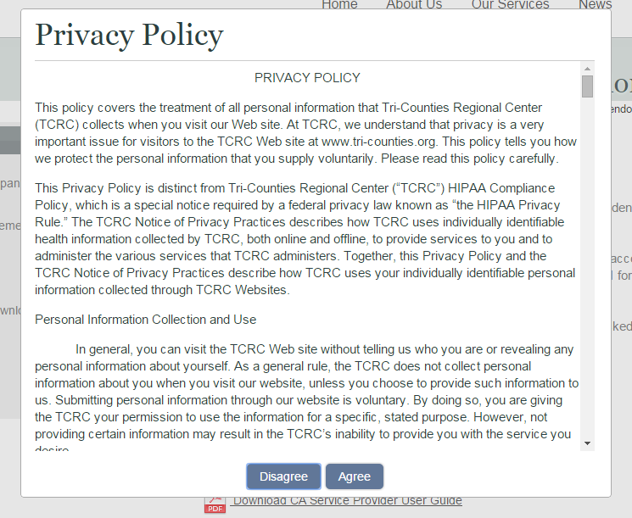
Privacy Policy
You will then be transferred to your portal account
You must agree with the Regional Center’s privacy policy

Slide 13
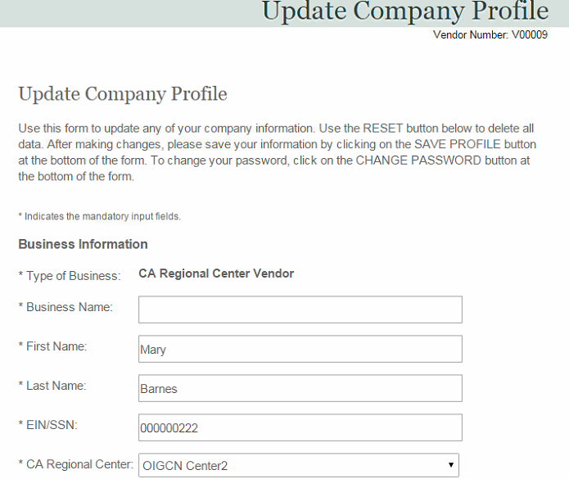
Company Profile
You will then be asked to update your Company Profile page
Please make the updates and hit “Submit” when completed

Slide 14
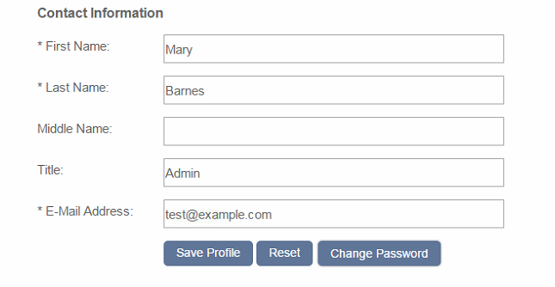
Portal Admin
To change your password, use the blue button at the bottom of the Company Profile page

Slide 15
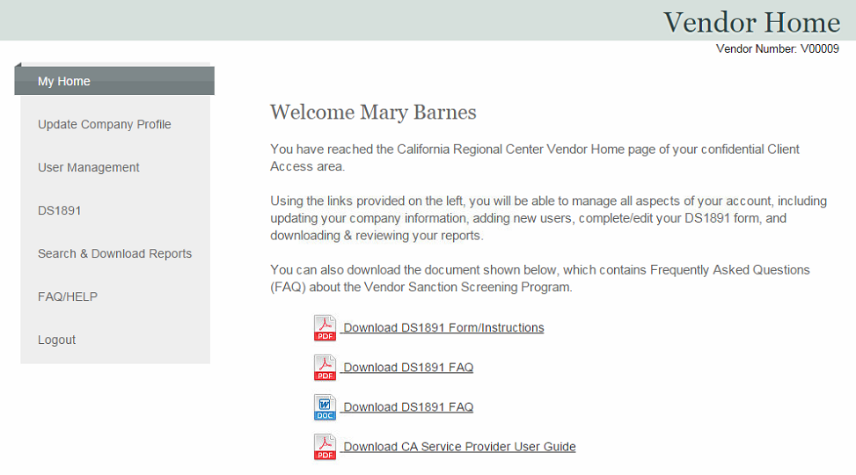
Home Page
On the Home page, you will see links on the left to access all pages
You can use the icons to download the DS form and FAQ
You can also download instructions on how to use the portal

Slide 16
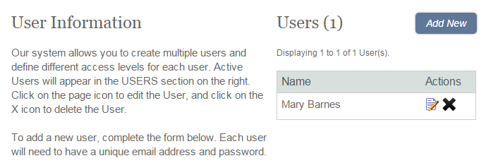
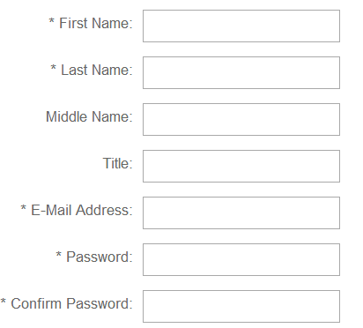
User Management
You can add more users on the User Management page
Click on the ADD NEW button at the top of the page
Fill in the contact fields; each user needs an email address and password
New users will be added to the Users table above

Slide 17
DS1891 Form
On the Home page, there is a link for updating your DS1891 form

Slide 18
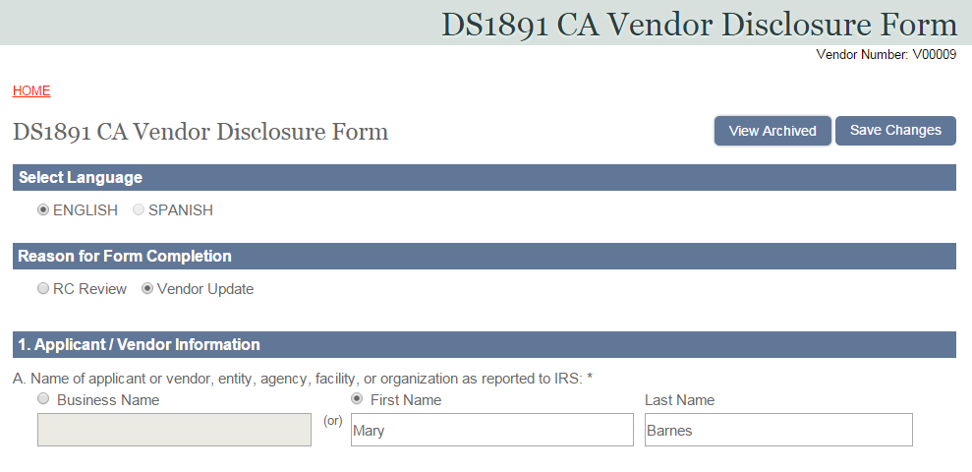
DS1891 Form
Select one of the buttons for Reason for Form Completion
You can see the definitions on the screen by hovering over the two options

Slide 19
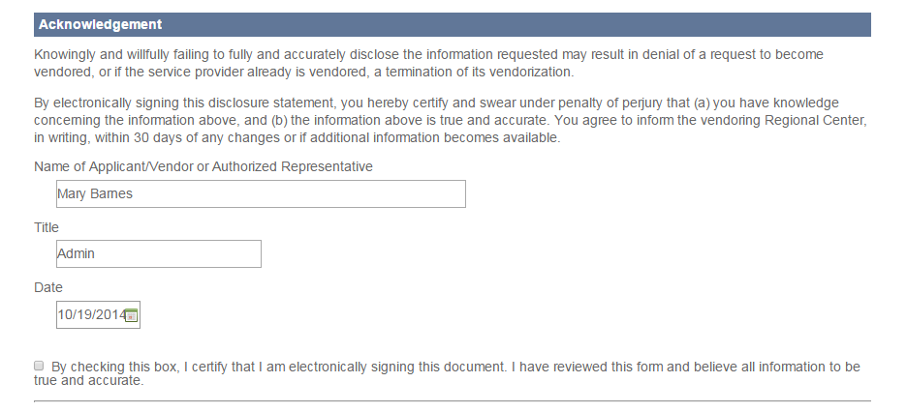
DS1891 Form
Complete the rest of the form; enter as much information as possible
When you are finished, you must check the box at the bottom of the form
You will get an error message if any fields are incomplete or need corrections

Slide 20
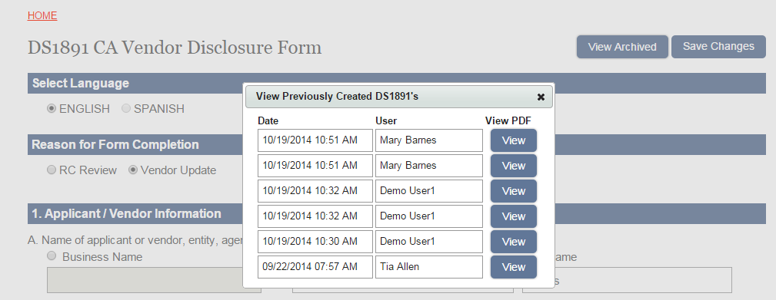
DS1891 Form
All versions of your form will be saved
To access them, click the View Archived button at the top of the form
You will see a list showing who made the changes and when
You can click on the View PDF icon to see a version of each form

Slide 21
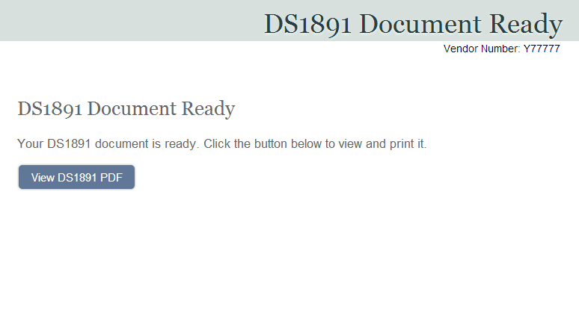
DS1891 Form
After you complete your form, click the blue button to view and print the completed form.

Slide 22
DS1891 Form
To see the results of your screening, login and go to the Home page
Click the Search & Download Reports button to see the page where you can download your screening report

Slide 23
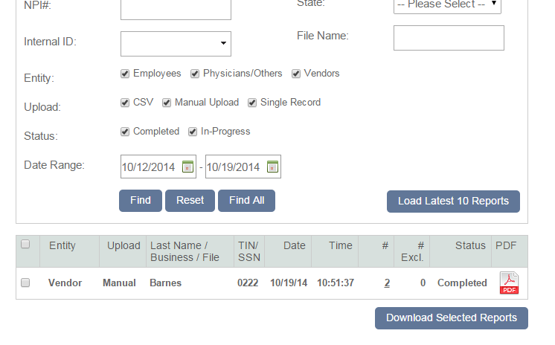
Download Screening Report
Click the blue button for Load Latest 10 Reports
You will see one record for your screening report; you will have only one current screening report in the system at a time
When the Status shows as “Completed”, you will see a PDF icon for your report; click the PDF icon to download and view your report

Slide 24
Download Screening Report
Your report will show that no whether any exclusions have been found (see next slide)
TCRC will have access to your report using the portal; you do not need to send a copy to them
Staff at OIG/CN will automatically screen the names on your form and contact you if they need any assistance

Slide 25
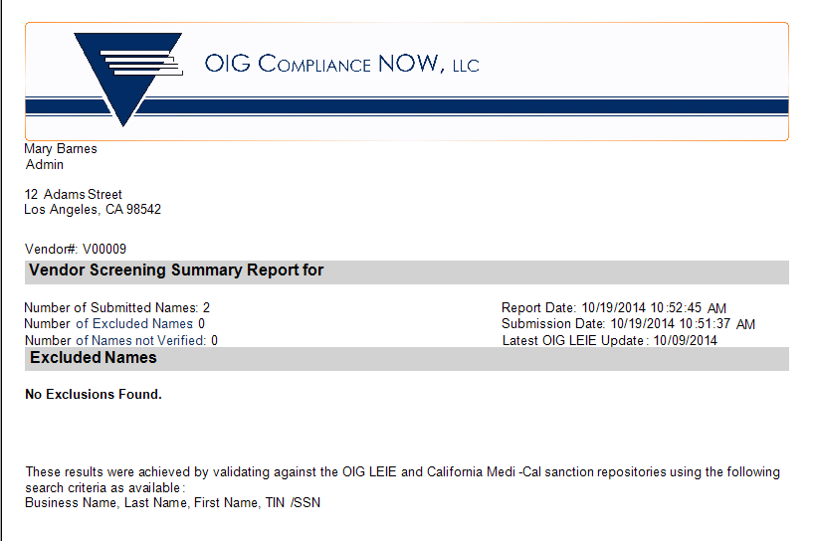
Download Screening Report

Slide 26
Biennial Screenings
You will receive a communication from TCRC each time it is necessary to make updates to your DS1891 form.
Simply repeat the procedures outlined here for making updates to your form(s).

Slide 27
*Super Vendors
*Vendors with multiple vendor numbers

Slide 28
Super Vendors
If you have more than one vendor number, your vendor numbers will be linked together in a single account based on the Tax ID Number
Super Vendors will be able to manage all linked DS forms using a single portal account and email address
You will be provided with a password and vendor number combination to access your linked account
Complete the Registration process using the password and vendor number provided to you by TCRC
You will see all linked vendor numbers on your Home Page
Notes:
What happens if they have more than one tax ID number? Will they need to have more than one account?

Slide 29
More Than One Tax ID Number
If you have vendor numbers that are associated with different tax IDs, you will be asked to set up an account with a separate email address and password for each vendor number/Tax ID combination.
TCRC will select a vendor number and password combination that will be used for registration of each account, and will communicate this information to you prior to registration.
Entering this combination during registration will link the vendor numbers into a single account for each Tax ID.

Slide 30
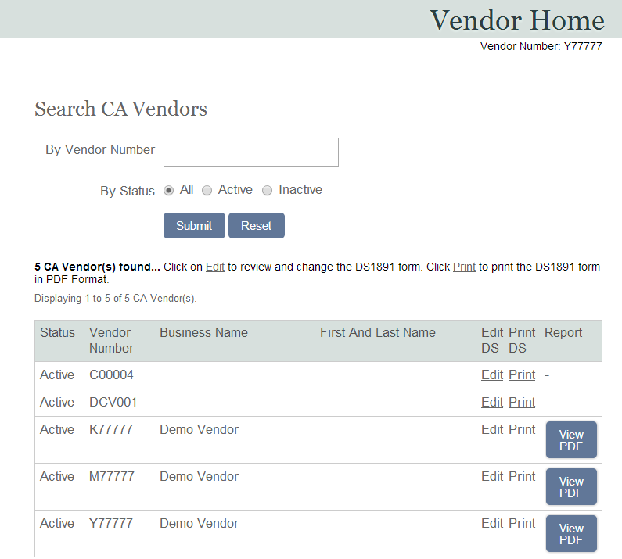
Super Vendor Home Page
You will access information for all your vendor numbers from the Home page
Click on each Edit DS link to make updates to the DS form for that vendor #; you must update and submit each form separately for screening to occur
Use the Print DS link to print each form
Once the report is ready, click the blue View PDF icon to see the report

Slide 31
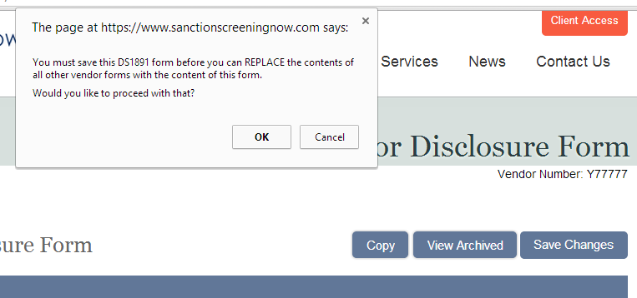
Form Copy Feature
You can use the COPY button to copy all information to each form
If you have many forms to complete, it will be easier to complete one form, then copy all fields to the other forms, then make changes as necessary

Slide 32
Portal Login

Slide 33
Portal Login
When you access your account after Registration, you will use the orange Login button at the top of the portal page
www.sanctionscreeningnow.com

Slide 34
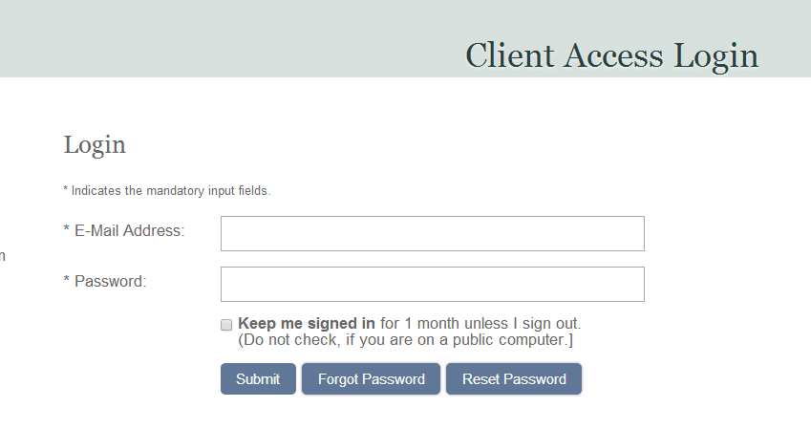
Login
Enter your email address and password, then hit Submit
You can Reset your password using this page, or you can retrieve your forgotten password, by using the blue buttons below

Slide 35
Comments
Direct vendorization questions to TCRC’s Resource Development staff.
Direct portal and screening questions to OIG/CN:
  Toll free: (866) 237-7711 or (607) 240-2400
  Ask for Tia Allen or Cathy Wolfanger
  Email at info@oigcompliancenow.com

